Slide 1
Real-time Urban Traffic Monitoring By Using Transit Buses As Probes
Shangkun Jiang, Yuran Sun, Wai Wong*, Yiming Xu, Xilei Zhao
01/10/2024
Notes:
Good morning, everyone, it’s my honor here to present our recent work, entitled the Real-time Urban Traffic Monitoring Using Transit Buses as Probes.

Slide 2
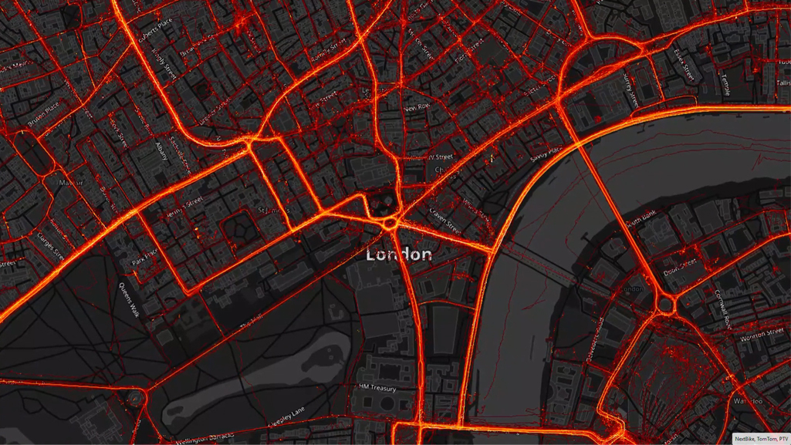
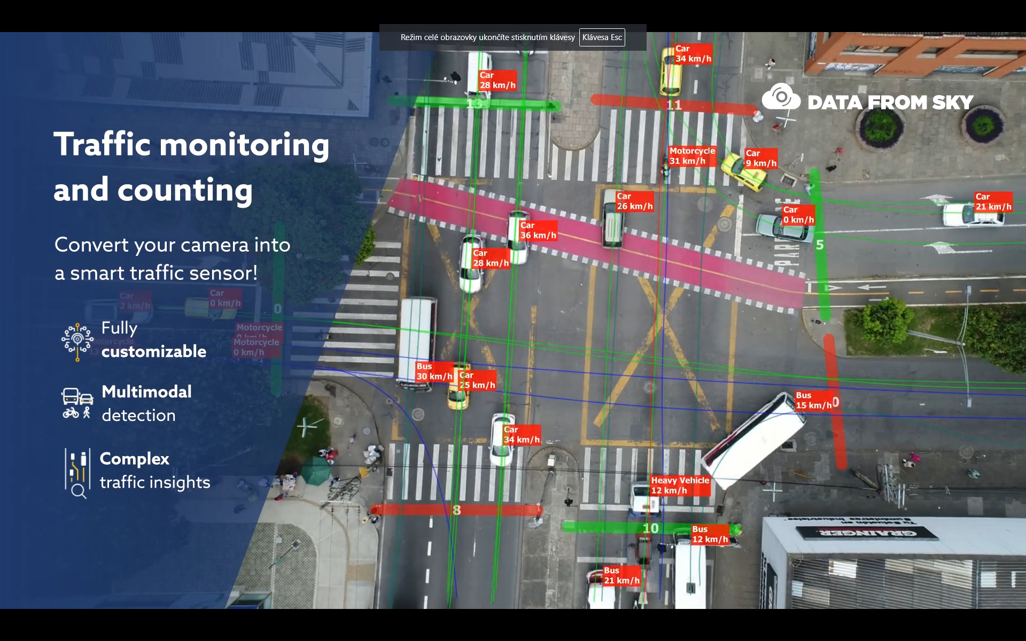
Research Motivation
Real-time urban traffic monitoring is a critical component in ITS and smart city development.
However, challenges persist in immediate access to the real-time data.
Cost
Privacy
Coverage
Accuracy
Accessibility
…
Source: https://blog.ptvgroup.com/en/city-and-mobility/big-data-mobility/
Source: https://datafromsky.com/news/datafromsky-real-time-traffic-monitoring/
Notes:
Realtime urban traffic monitoring plays an important role in the smart cities and intelligent transportation system. However, despite there are a lot of datasets can be used for real-time traffic monitoring, there still exist many problems such as the high cost and privacy issue.

Slide 3
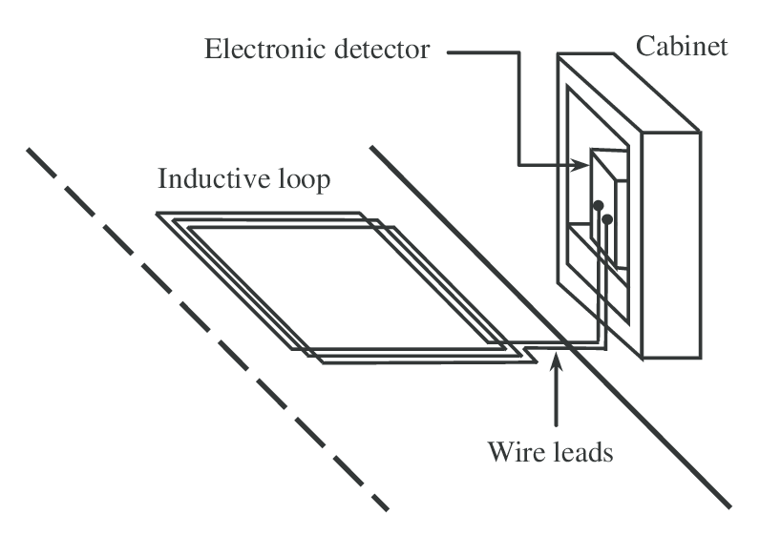
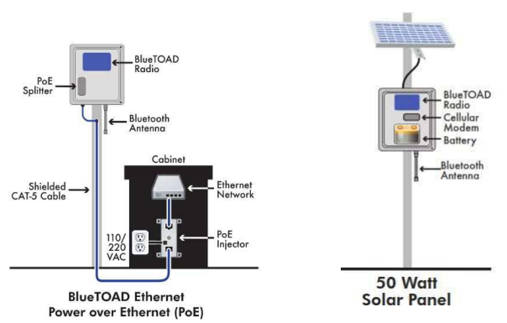
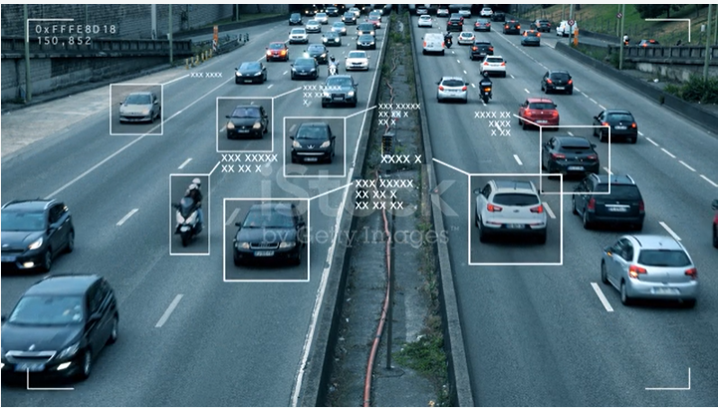
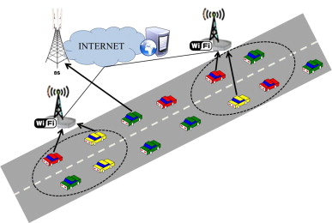
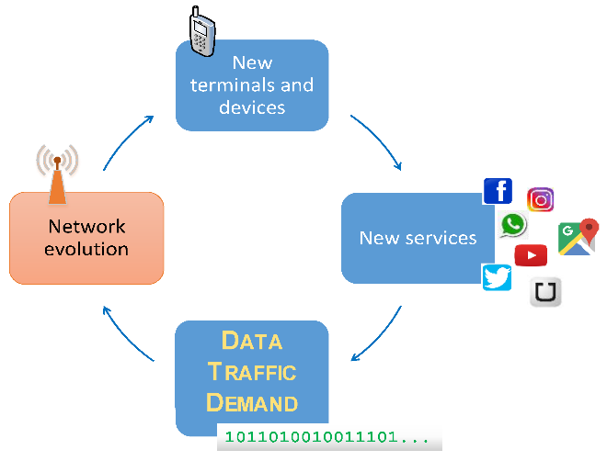
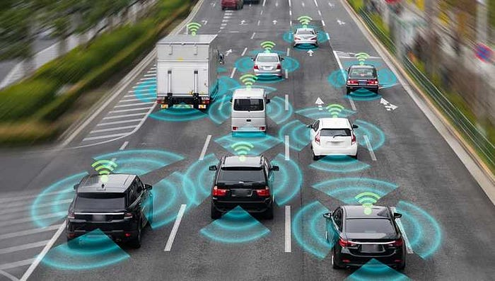
Research Motivation
On-road fixed detectors:
Loop detectors Bluetooth Video camera
Mobile data sources:
Connected vehicles
Floating cars
Location-based service data
Notes:
To be more specific, the existing datasets to monitor real-time traffic conditions can be categorized into two parts, i.e., on-road fixed detectors, (such as loop detectors, Bluetooth and video camera), which can be used to collect the three basic traffic parameters like traffic flow and density. The other data type is the mobile data sources (such as probe vehicles, mobile device data).

Slide 4
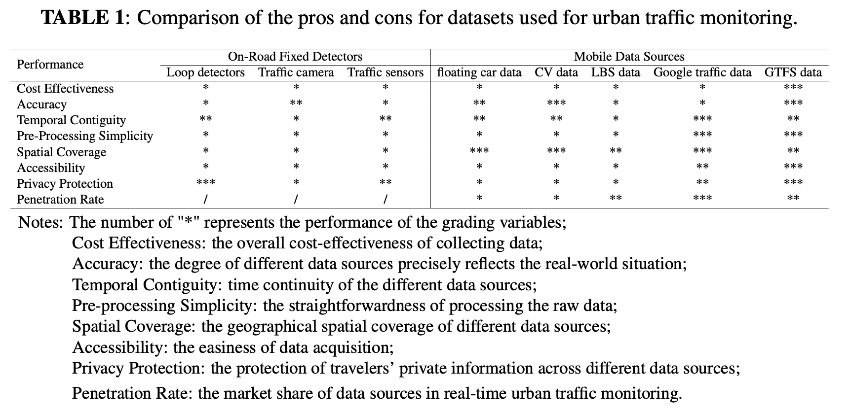
Research Motivation
Notes:
As we can see, for these on-road fixed detectors, the main problems are the high cost and the limited coverage. However, for the mobile data sources, there may exist some privacy issues.

Slide 5
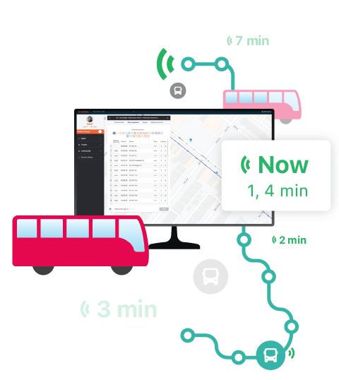
GTFS data description
An open standard data used for publishing public transit information to passengers.
Public accessibility
No privacy concerns
GTFS Static data
Defines fixed schedules and geographic information for public transport services.
GTFS Realtime data
Dynamic updates, including real-time bus speed and location.
Notes:
That because GTFS data includes huge transport information and totally open to the public without any privacy issue.
The GTFS data contains two parts, the static data which shows bus routes/ schedule/ stop locations, which can serve as a complementary data source for GTFS Realtime data, which records the bus dynamic update information.

Slide 6
GTFS data description
An open standard used for publishing public transit information to passengers.
Public accessibility
No privacy concerns
GTFS Static data
Defines fixed schedules and geographic information for public transport services.
GTFS Realtime data
Dynamic updates, including real-time bus speed and location.
Notes:
The GTFS data contains two parts, the static data which shows bus routes/ schedule/ stop locations, which can serve as a complementary data source for GTFS Realtime data, which records the bus dynamic update information.

Slide 7
GTFS data description
An open standard used for publishing public transit information to passengers.
Public accessibility
No privacy concerns
GTFS Static data
Defines fixed schedules and geographic information for public transport services.
GTFS Realtime data
Dynamic updates, including real-time bus speed and location.
Notes:
So, we need a data type without these shortages, and GTFS data is a good choice. Since it is totally open to the public without any privacy concerns.
The GTFS data contains two parts, the static data which shows bus routes/ schedule/ stop locations, which can serve as a complementary data source for GTFS Realtime data, which records the bus dynamic update information.

Slide 8
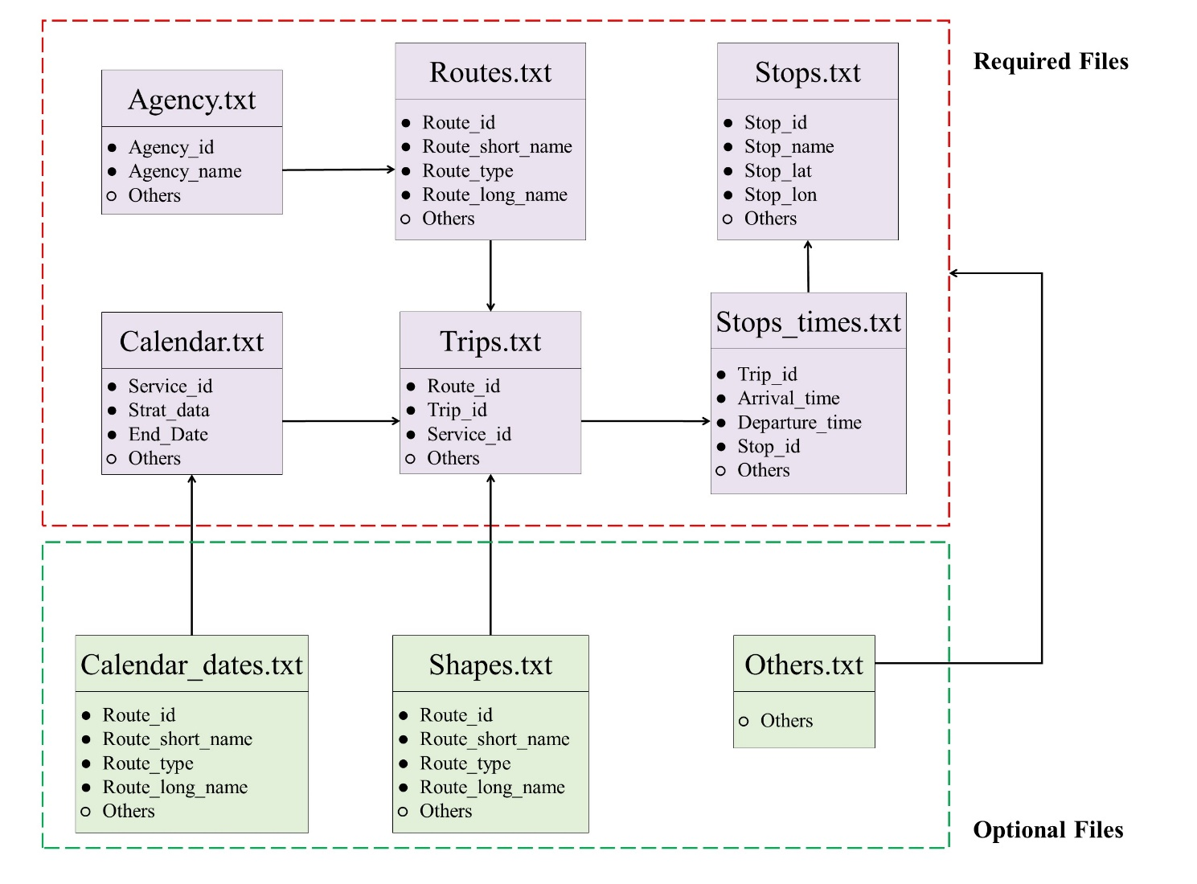
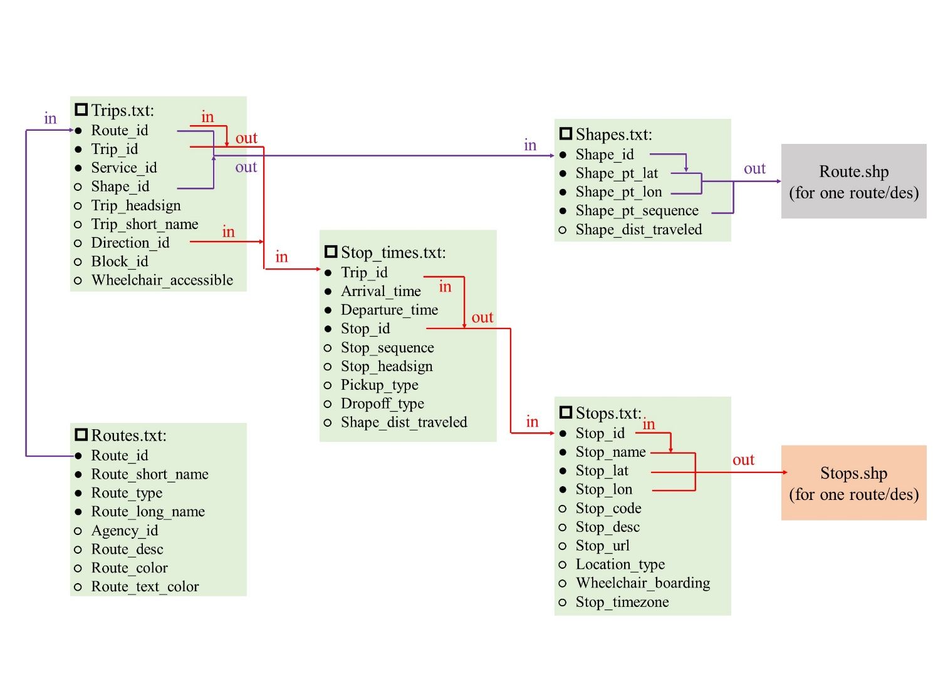
GTFS data description
Bus_route.shp
Bus_stop.shp
Static data
Notes:
To be more specific, GTFS Static data is a combination of many files, which records the bus routes, bus schedule and bus stops. So, we can get these information, such as bus stops and bus routes by combination them together.

Slide 9
GTFS data description
Realtime data
Position: lat, lon, speed, direction, odometer
Congestion Level: Class 1~5, up to agency
Occupancy Status: available space for bus, empty to unavailable
Vehicle Stop Status: coming at/ stopped at / transit to
Vehicle Descriptor: ID, Label, License plate
Vehicle Positions
Time Range: time coverage for alert
Entity Selector: specify exactly which parts of the network this alert affects
Cause
Effect: no service, detour…
GTFS Realtime
Service Alerts
Trip Updates
Stop Time Update
Trip Descriptor
Uncertainty
Notes:
As for GTFS Realtime data, it contains three parts, the vehicles positions, service alerts and trip updates. The information we used in this research is the bus position information, which contains bus location, and speed.

Slide 10
Research Questions
Can GTFS Realtime Data be used for real-time network sensing?
Bus travel patterns → on/off boarding → different from normal traffic
Bus travel speed → low → different speed variation pattern
How to validate the results?

Slide 11
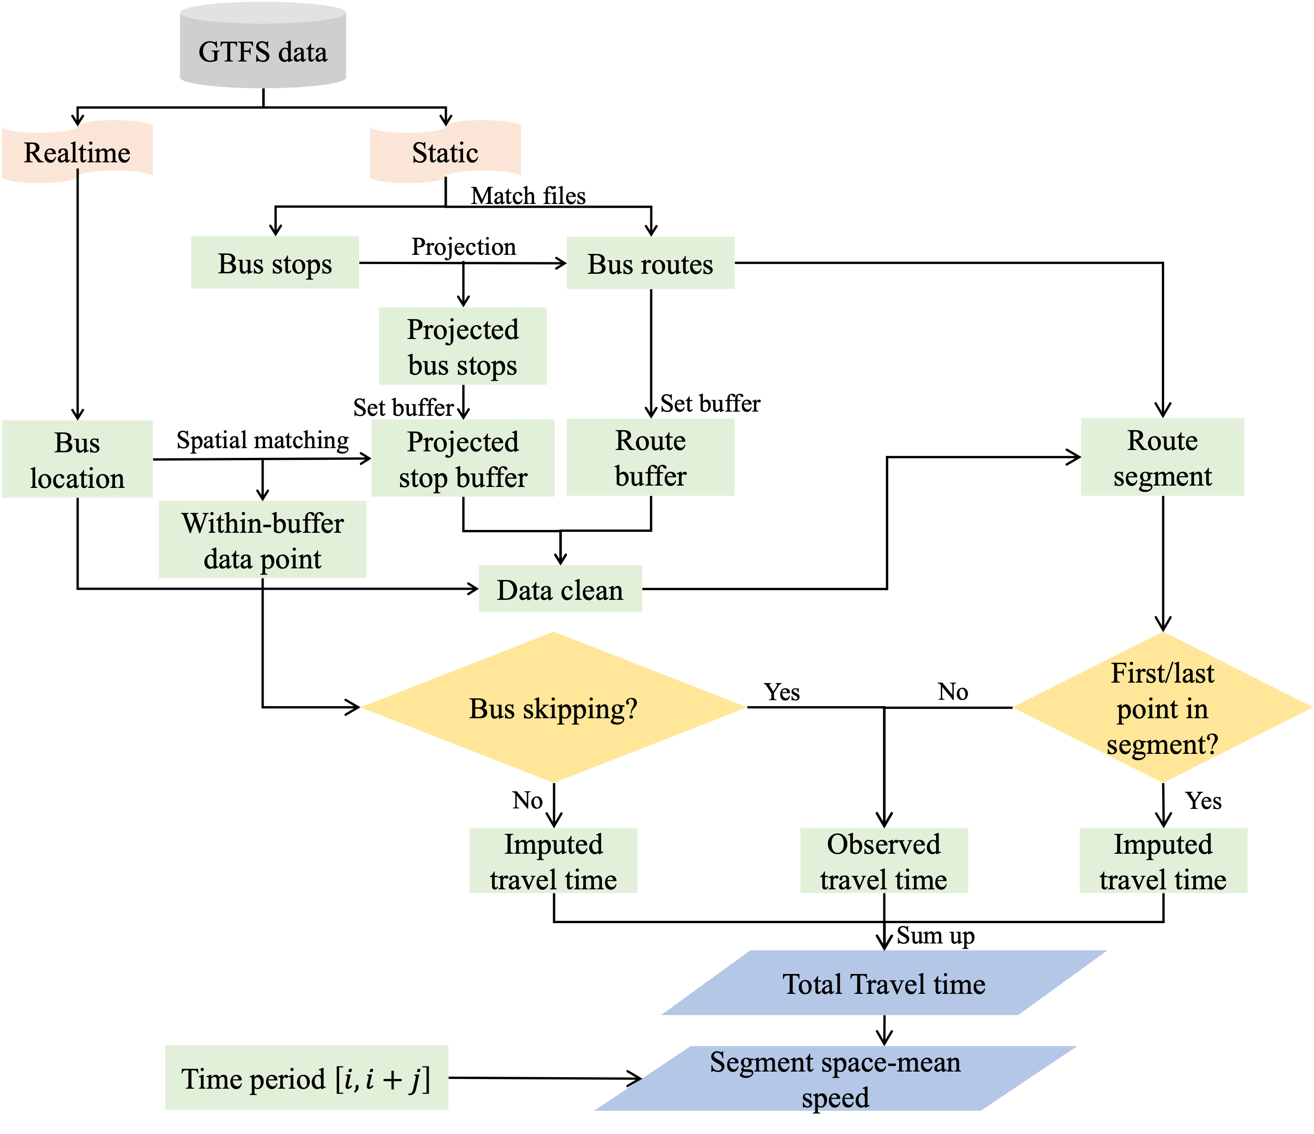
Methodology
Overview
Metric: Speed
Data Collection
Pre-processing
Trip Identification
Travel Time Estimation

Slide 12
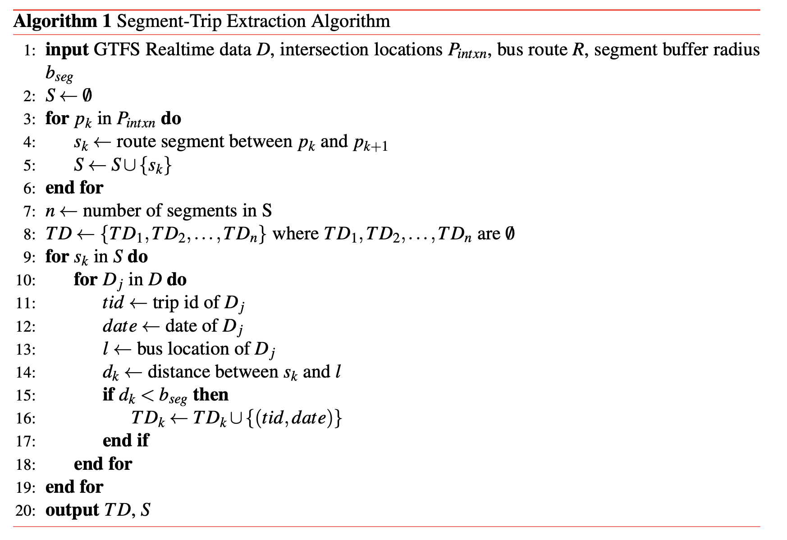
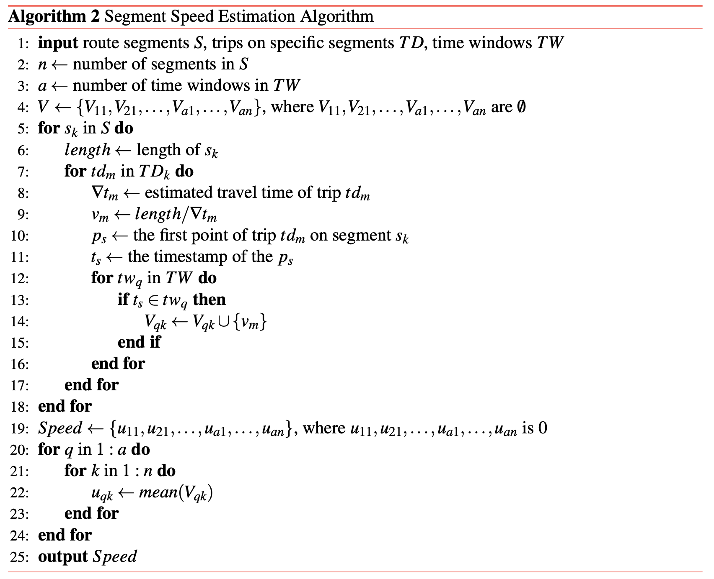
Methodology
Focus on the specific road segment
Travel speed estimation
Notes:
The first one is the segment-trip extraction algorithm, which can automatically extract all the road segment in the research area. And the second algorithm is to estimate the bus travel speed on that segment by using the route length divided by travel time.

Slide 13
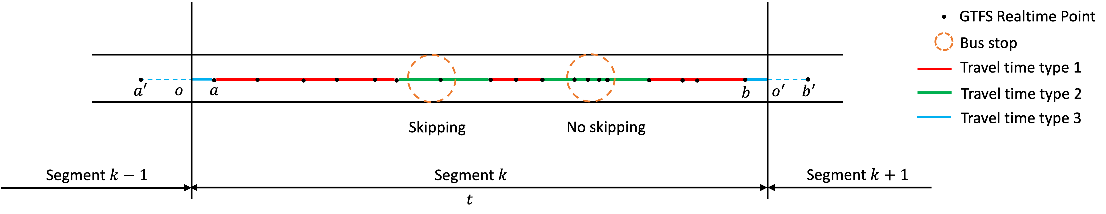
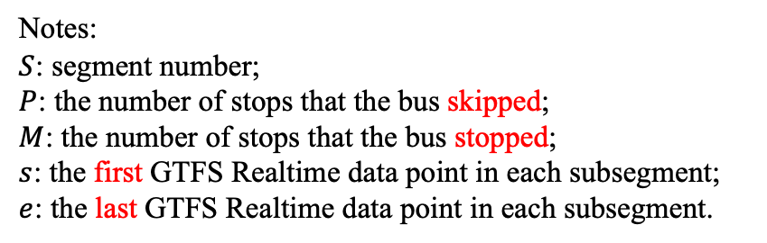
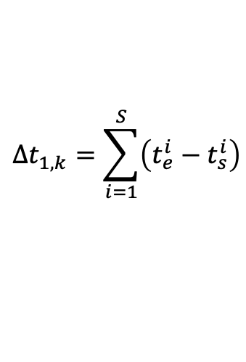
Methodology
Travel Time Estimation
Notes:
$S$: segment number;
$P$: the number of stops that the bus skipped;
$M$: the number of stops that the bus stopped;
$s$: the first GTFS Realtime data point in each subsegment;
$e$: the last GTFS Realtime data point in each subsegment.
$$Δt_{1,k}=\sum_{i=1}^{S}{\left(t_{e}^{i}−t_{s}^{i}\right)}$$
Notes:
T1: the travel time for passing through subsegments that are neither near intersections nor within the stop buffers;
Therefore, we estimate the speed of a segment by using the travel time of the road section, which is the ratio of the road section length to the travel time. So, considering the different driving characteristics of buses when passing through bus stops and intersections, we have defined three different types of travel time. Specifically, travel time type 1 represents the travel time for passing through subsegments that are neither near intersections nor within the bus stop. Therefore, it can be estimated by obtaining the sum of the time differences between the last and first data points within each subsegment.

Slide 14
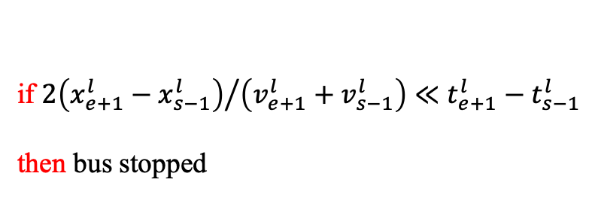
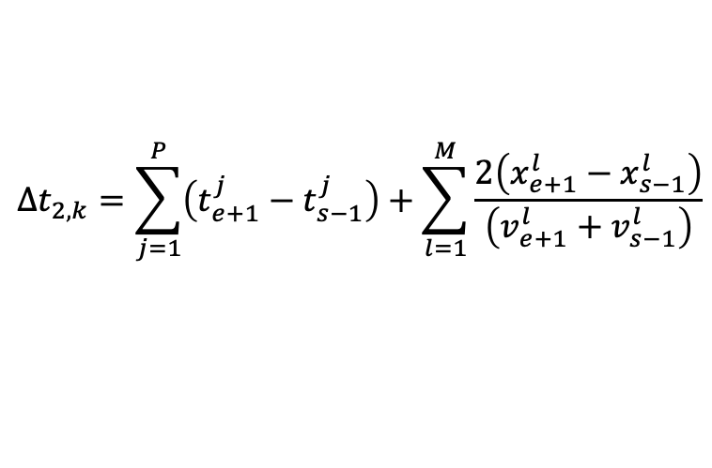
Methodology
Travel Time Estimation
$$Δt_{2,k}=\sum_{j=1}^{P}{\left(t_{e+1}^{j}−t_{s−1}^{j}\right)}+\sum_{l=1}^{M}{\frac{2\left(x_{e+1}^{l}−x_{s−1}^{l}\right)}{\left(v_{e+1}^{l}+v_{s−1}^{l}\right)}}$$
if ${2\left(x_{e+1}^{l}−x_{s−1}^{l}\right)}/{\left(v_{e+1}^{l}+v_{s−1}^{l}\right)}≪$ $t_{e+1}^{l}−t_{s−1}^{l}$
then bus stopped
15s^{[1]}
Bus skipping
Bus stop
[1] Prathibaa, K. and K. Gunasekaran, Planning of Bus Stops for Safe and Effecient Passenger Boarding and Alighting. Planning, Vol. 5, No. 06, 2016.
Notes:
T2: the travel time for passing through the stop buffers
To estimate the characteristics of normal traffic using the speed of buses, we need to identify the differences between them. The main difference lies in the possibility of buses stopping at bus stops. In such cases, we cannot directly use the difference in timestamps; instead, we should interpolate the time taken to pass through bus stops. Therefore, we introduce a travel time type 2. When the average time taken to pass through a bus stop is significantly less than the recorded time in the timestamp, we consider that the bus has made a stop. Hence, the calculation of travel time type 2 comprises two independent parts.

Slide 15
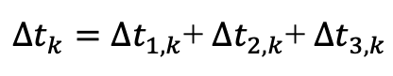
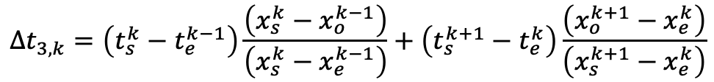
Methodology
Travel Time Estimation
$$Δt_{3,k}=\left(t_{s}^{k}−t_{e}^{k−1}\right)\frac{\left(x_{s}^{k}−x_{o}^{k−1}\right)}{\left(x_{s}^{k}−x_{e}^{k−1}\right)}+\left(t_{s}^{k+1}−t_{e}^{k}\right)\frac{\left(x_{o}^{k+1}−x_{e}^{k}\right)}{\left(x_{s}^{k+1}−x_{e}^{k}\right)}$$
$Δt_{k}=Δt_{1,k}$+ $Δt_{2,k}$+ $Δt_{3,k}$
Notes:
T3: the travel time for passing through subsegments adjacent to the intersections
Travel time type 3 primarily takes into account the time taken by buses to pass between two segments. The calculation method involves using the proportion of time span based on the ratio of the distances traveled.

Slide 16
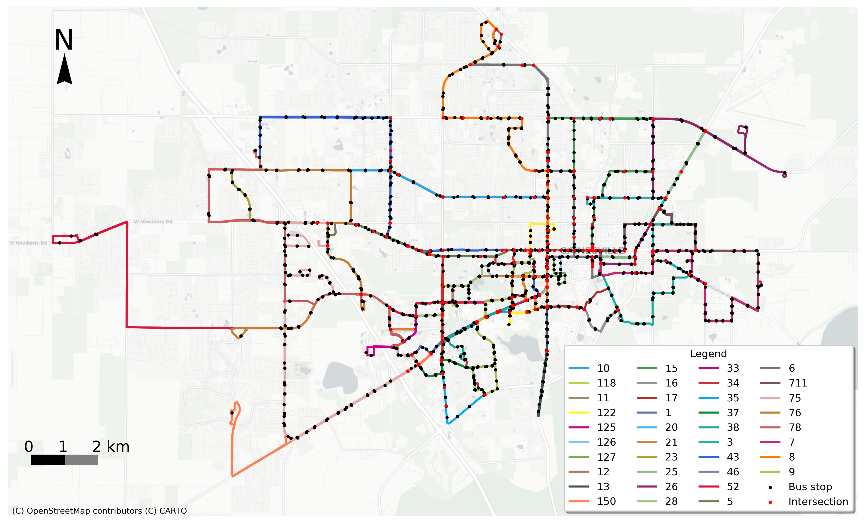
Case Study
Research Area
GTFS Realtime data:
Research area: Gainesville, FL
Time span: 2 weeks in Oct. 2023
6 am. → 11 pm.
Interval=15s
Records: 1.1 M → Originally
1.06 M → After Pre-processing
Gainesville, FL
Notes:
After that, we use our methods in Gainesville as a case study.
Study site: Gainesville, FL
Study period:
09/10/23 - 13/10/23 and 25/10/23 - 29/10/23
Data collected period: 6am. ~ 11pm.
Interval =15s. Bus routes = 34. Direction = 2
To validate our method, we chose Gainesville, Florida, for a case study. The spatial distribution of bus routes in Gainesville is quite extensive, and the data we collected spans two weeks in October 2023.

Slide 17
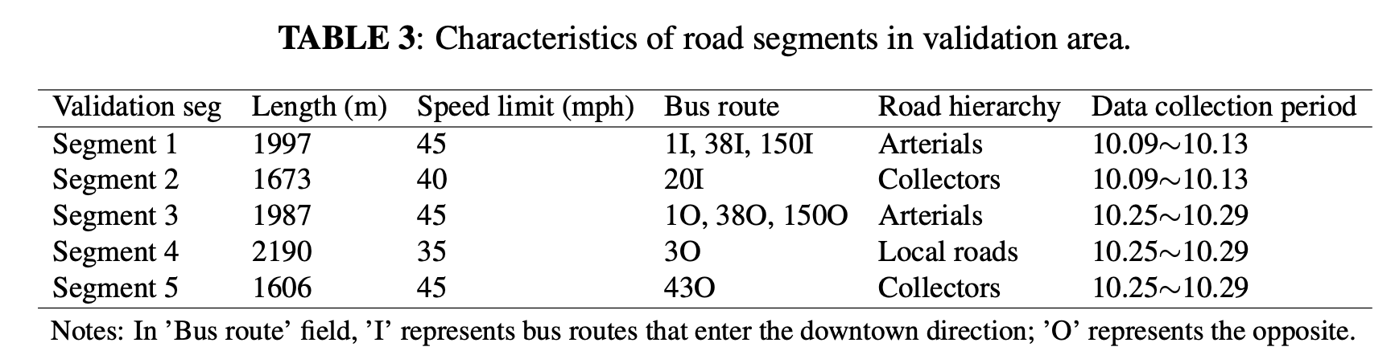
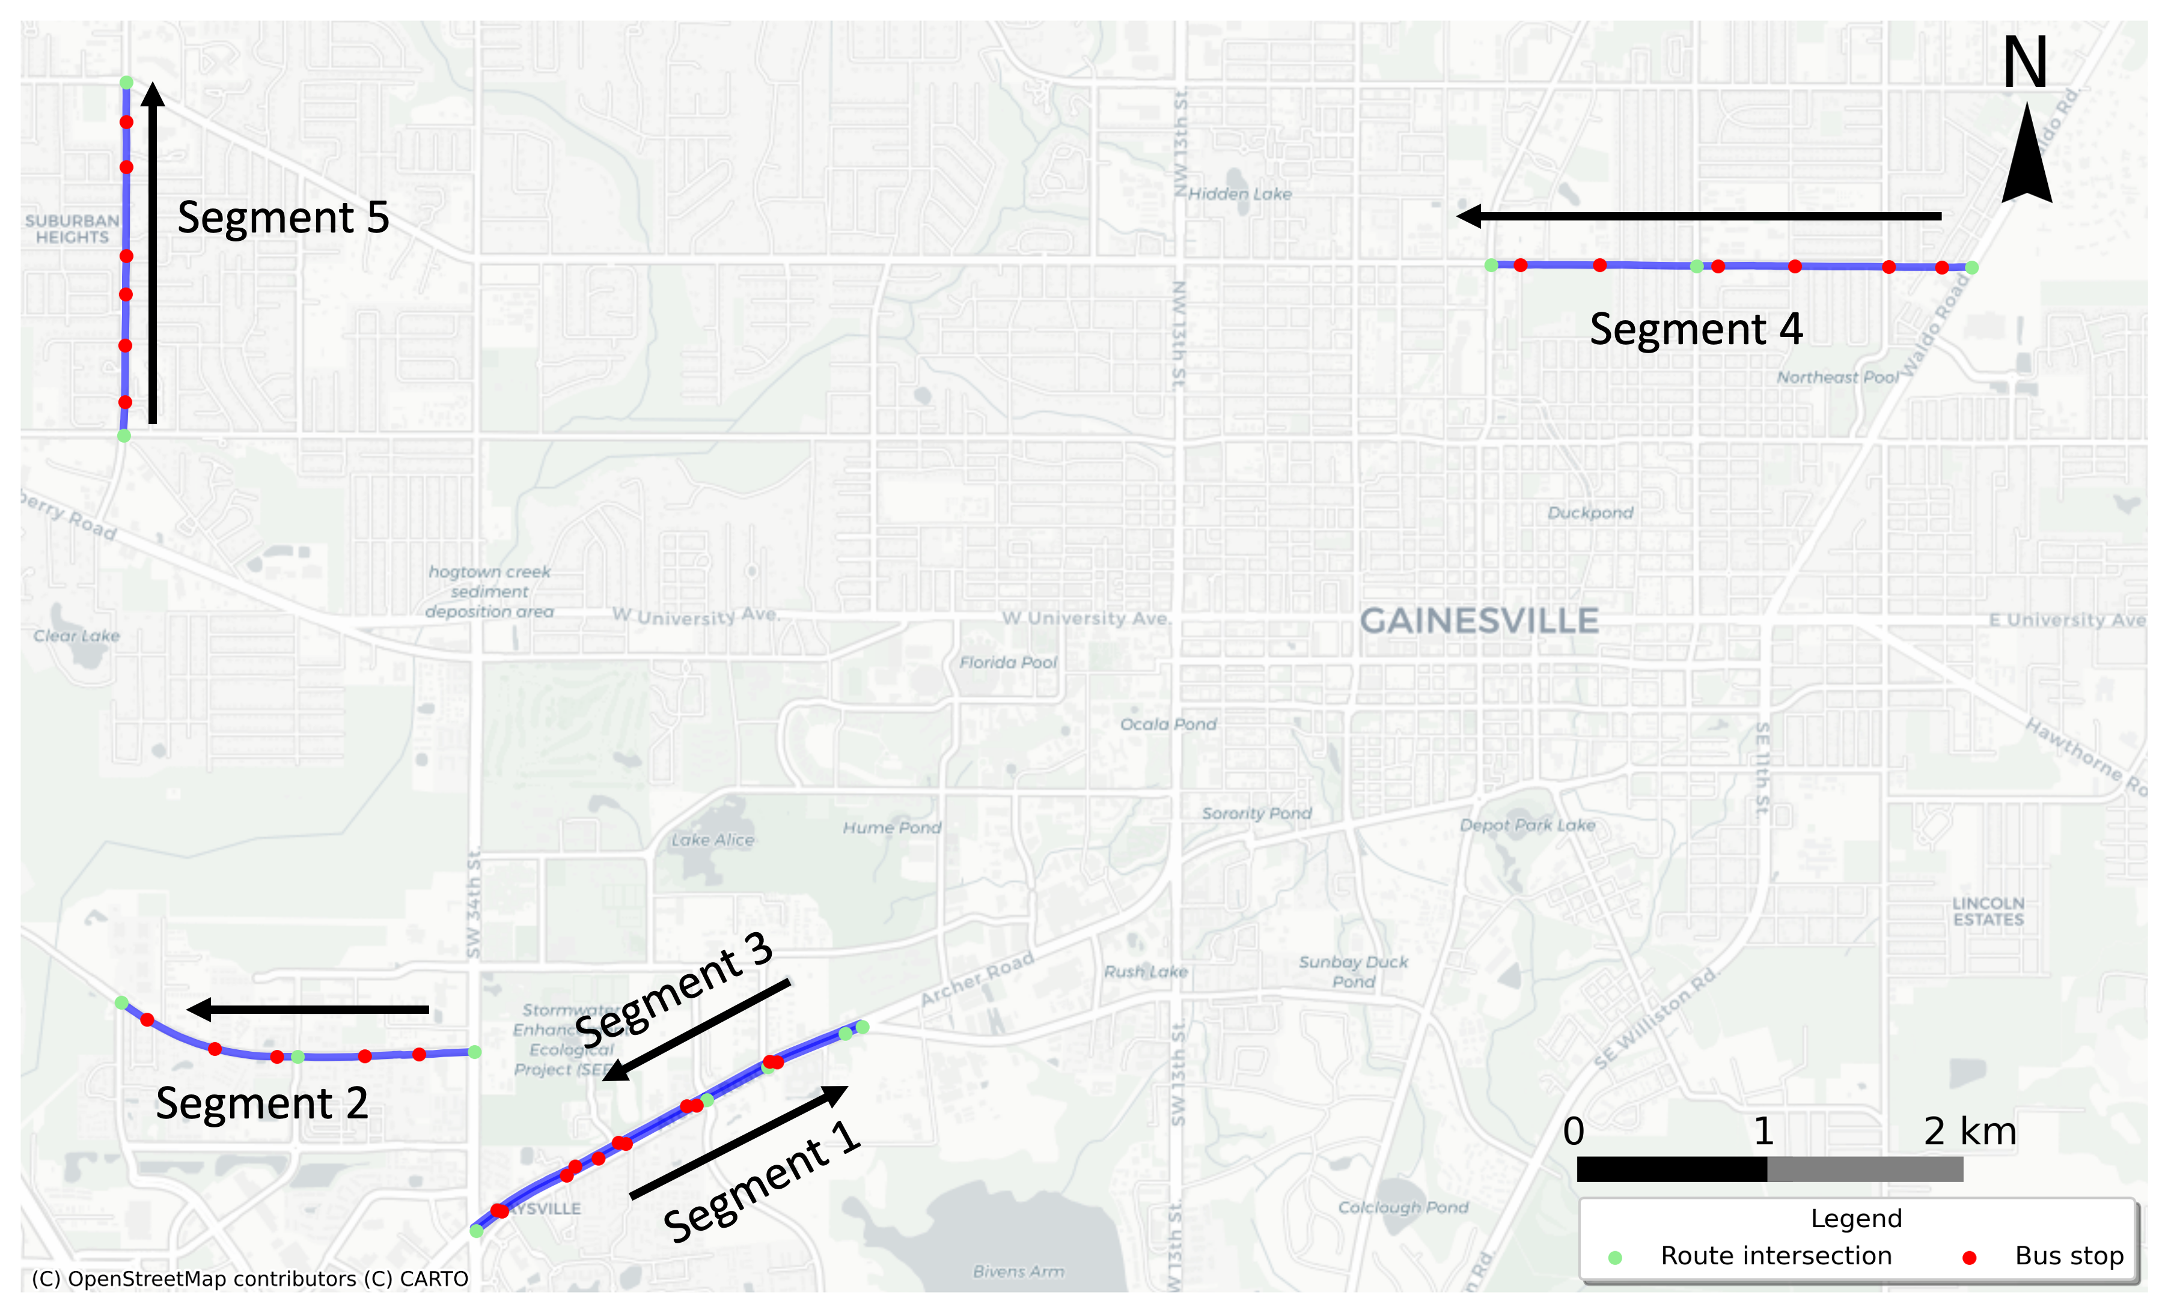
Case Study
Validation
Data collection:
GTFS Realtime data
Bluetooth data
Google Traffic data
Bus
Car
Notes:
To validate the accuracy of the results derived from GTFS Realtime data, a comparative analysis was conducted against the average segment speeds obtained from Google Traffic data and Bluetooth data.
These five segments have different road hierarchies and speed limits, which can adequately validate the applicability of the methods proposed.

Slide 18
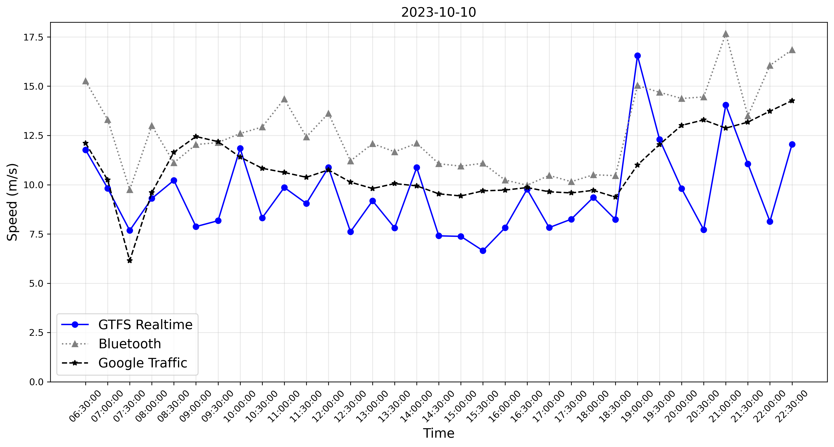
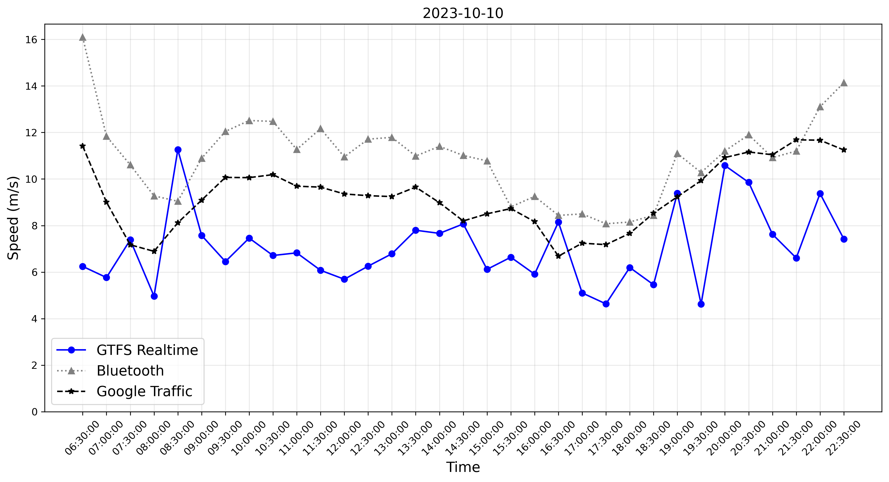
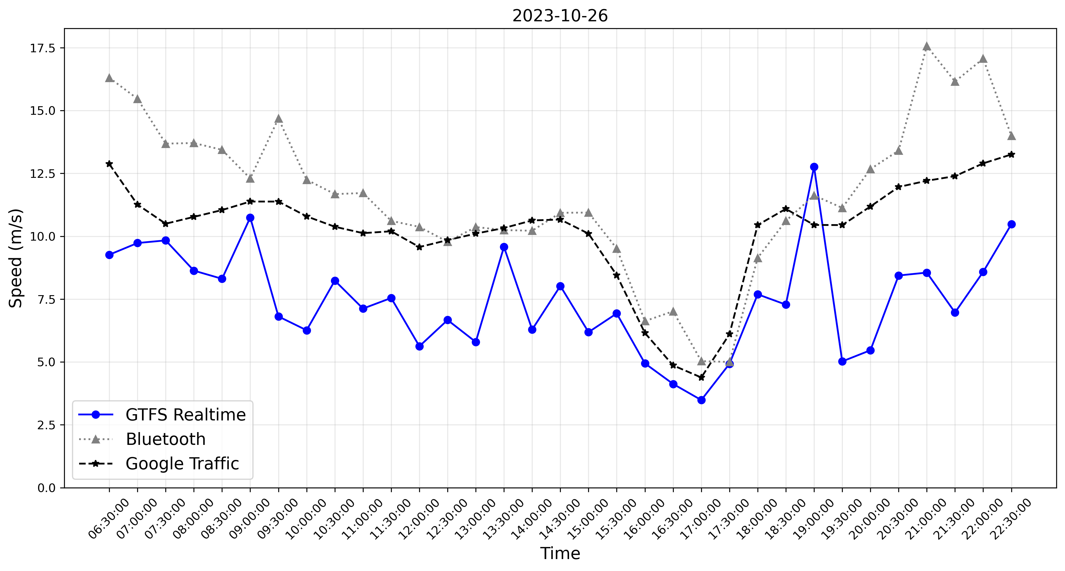
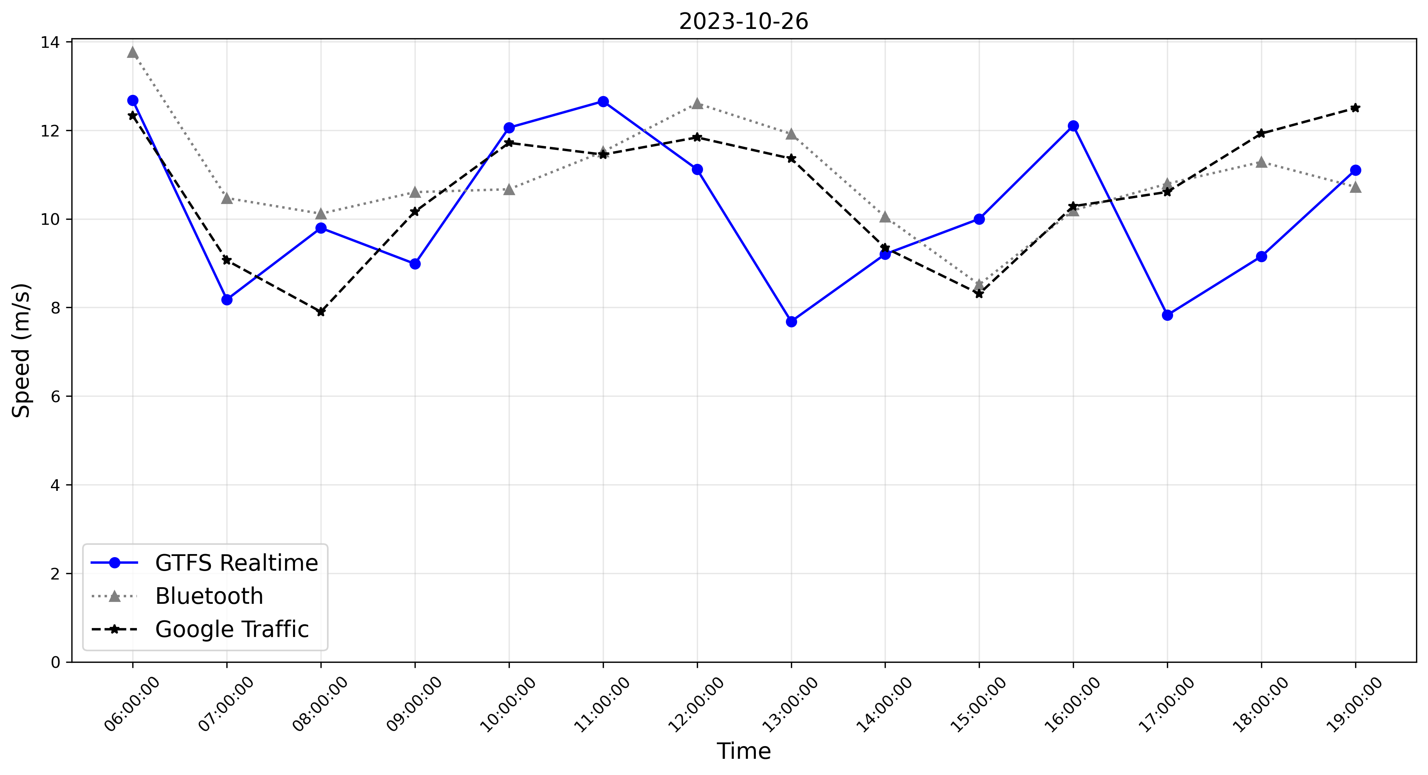
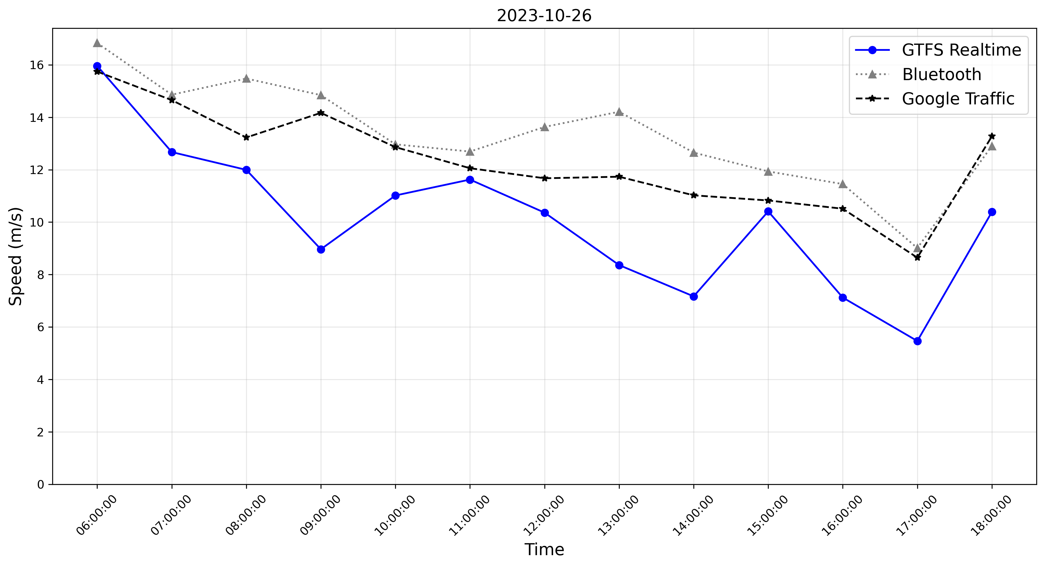
Case Study
Validation
Similar Speed variation pattern
Segment 1
Segment 2
Segment 3
Segment 4
Segment 5
Notes:
Zitaixiaole
youyufacuowu

Slide 19
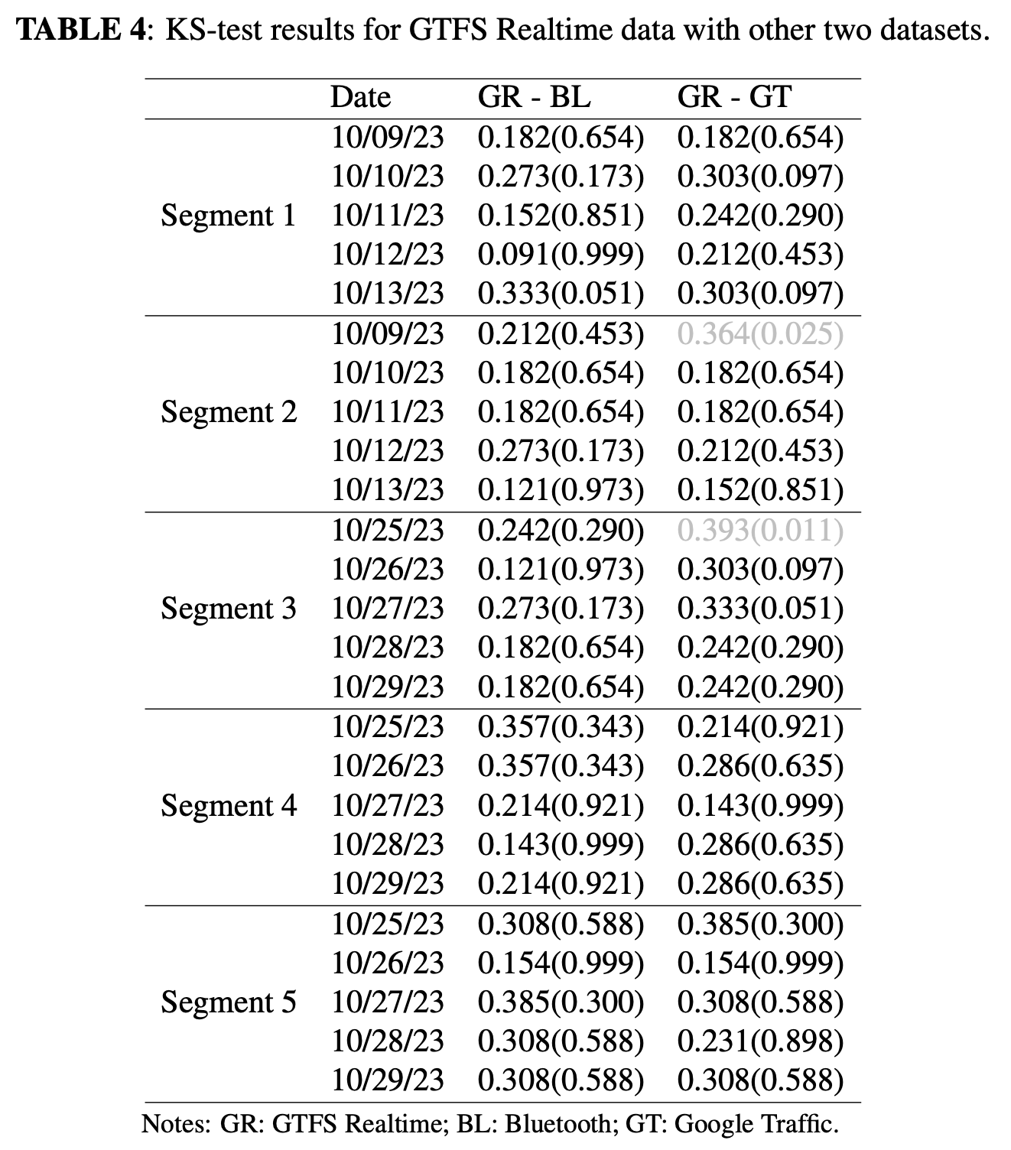
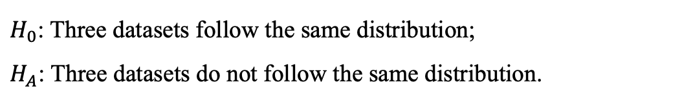
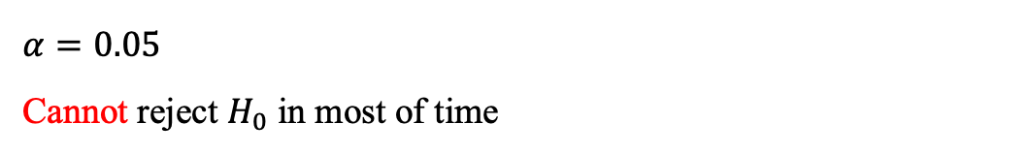
Case Study
Validation
Hypothesis test → Kolmogorov–Smirnov (KS) test
$H_{0}$: Three datasets follow the same distribution;
$H_{A}$: Three datasets do not follow the same distribution.
$$α=0.05$$
Cannot reject $H_{0}$ in most of time
Notes:
0.05

Slide 20
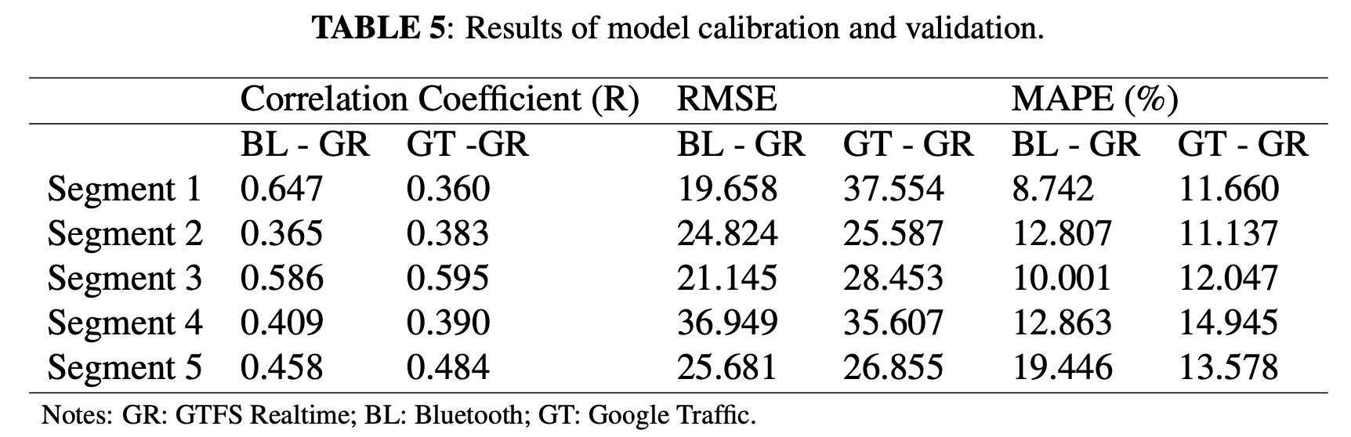
Case Study
Validation
Correlation and Error Analysis
Average travel time of the automobile (ATT) ~ average travel time of bus (BTT)
Cross validation: 80% data model fit – 20% data validation
Linear relationship
[2] Zhou, P., S. Jiang, and M. Li, Urban Traffic Monitoring with the Help of Bus Riders. In 2015 IEEE 35th International Conference on Distributed Computing Systems, 2015, pp. 21–30.
[3] Chakroborty, P. and S. Kikuchi, Using bus travel time data to estimate travel times on urban corridors. Transportation Research Record, Vol. 1870, No. 1, 2004, pp. 18–25.
[4] Kieu, L. M., A. Bhaskar, and E. Chung, Empirical modelling of the relationship between bus and car speeds on signalised urban networks. Transportation Planning and Technol- ogy, Vol. 38, No. 4, 2015, pp. 465–482.
Notes:
So, we used 80% of data to build a model to transfer the ATT to the BTT and then the rest data was calculated the model error of RMSE and MAPE. All results are lies in the reasonable range.
In general, linear relationships were observed with acceptable levels of correlation coefficient, with all values falling within a reasonable range (between 0.360 and 0.647). Most importantly, by comparing the values of MAPE and RMSE for BT - GR \& GT - GR, it is evident that GTFS Realtime-based travel time generally provided better predictions of Bluetooth-based travel time compared to Google traffic-based travel time, which incorporates unknown built-in algorithms.

Slide 21
Major Take-aways
GTFS Realtime data can effectively capture link speed variations;
Proposing a novel methodology to estimate real-time traffic speed based on GTFS Realtime data;
Validating the possibility of extending real-time network sensing to the spatial coverage by using GTFS Realtime data.
Notes:
GTFS Realtime data can effectively capture link speed variations;
Proposing a novel methodology to estimate real-time traffic by integrating GTFS Realtime, GTFS Static, and road network data;
validating the possibility of extending real-time network sensing to the spatial coverage of GTFS Realtime data.

Slide 22
Thank you !
Shangkun Jiang (jiang.shangkun@ufl.edu)
jiang.Shangkun@ufl.edu
Notes:
Good afternoon every, this time I will present my TRB work, that is the Real-time Urban Traffic Monitoring Using Transit Buses As Probes.

